Slide 1
United Airlines
Airline Safety and Crashes Executive Summary

Slide 2
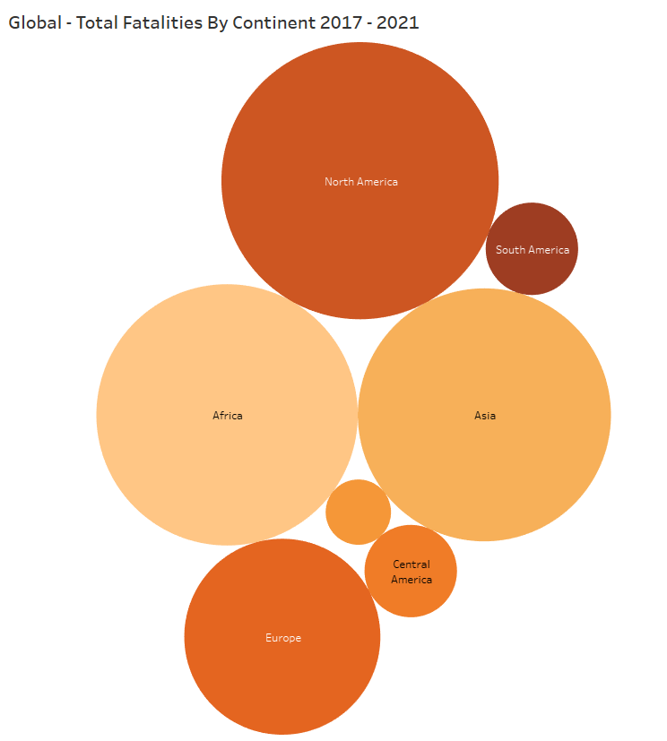
Global – Fatalities By Continent
North America highest fatalities
Africa and Asia to follow
Europe 4th

Slide 3
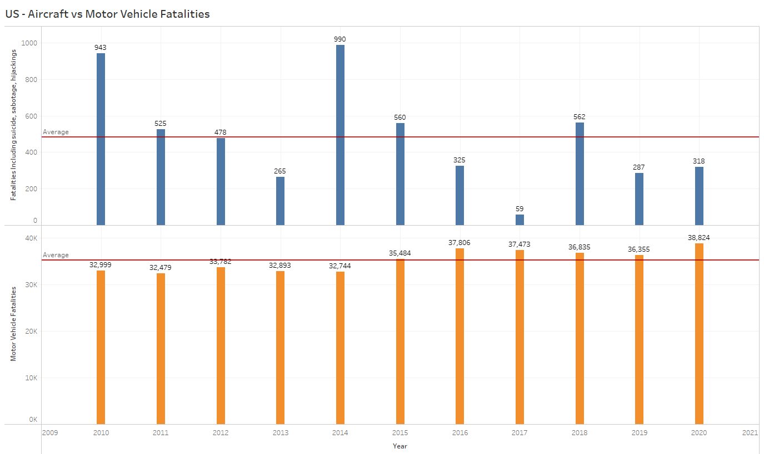
US – Aircraft vs Motor Vehicle

Slide 4
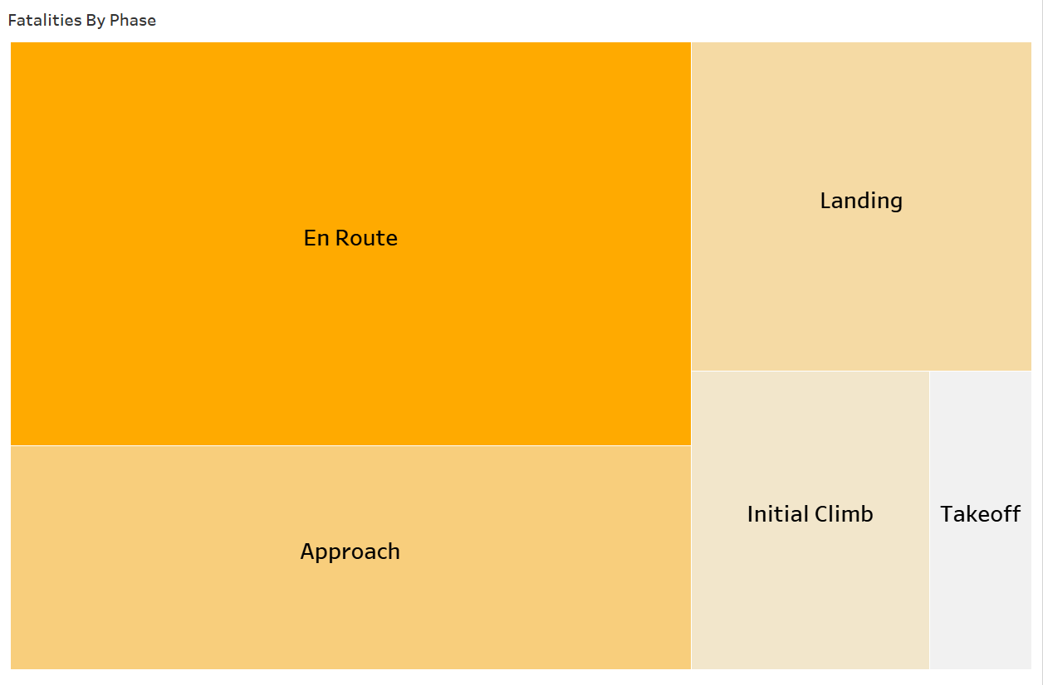
US – Fatalities By Phase

Slide 5
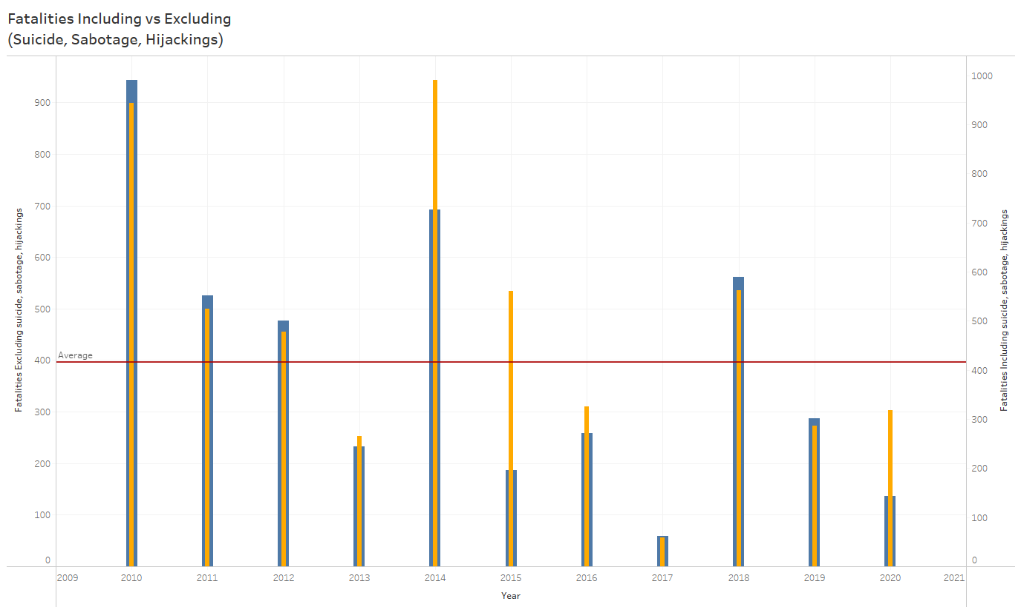
US – Fatalities Including vs Excluding (Suicide, Sabotage, Hijackings)
Fatalities excluding below average after 2014 except for 2018
Fatalities including are higher in:
2013
2014
2015
2016
2020

Slide 6
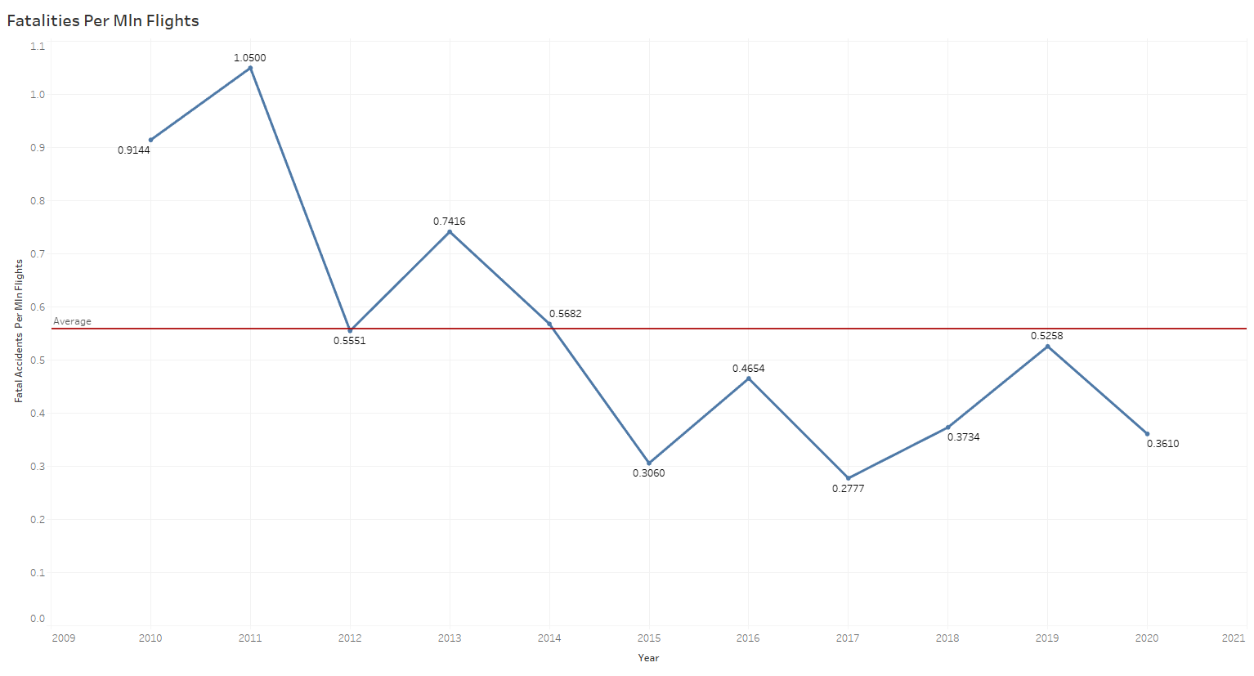
US – Fatalities Per Million Flights
Below 1 post 2011
Below average post 2014

Slide 7
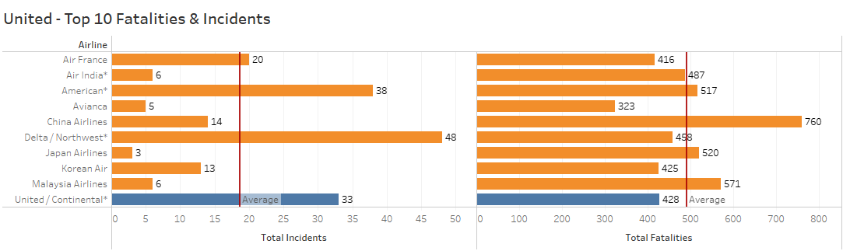
United – Top 10 Airline Incident & Fatality Count
United stands high (3rd ) on incidents and above average
United stands below average on fatalities

Slide 8
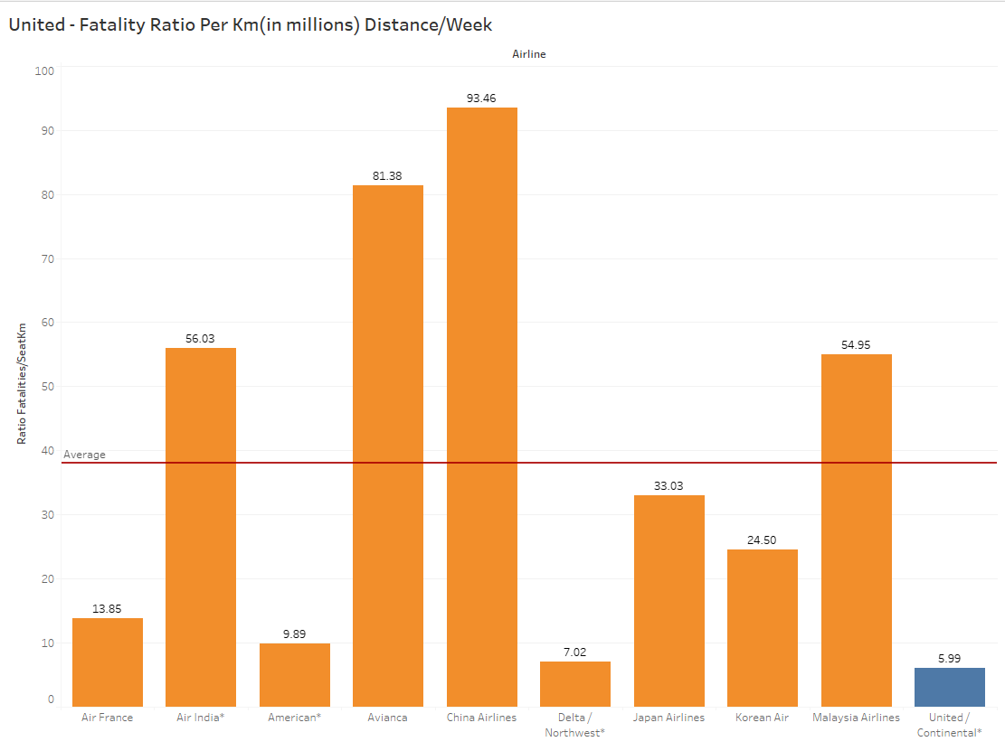
United - Fatality Ratio Per Km(in millions) Distance/ Week
Lowest fatality ratio compared to all airlines listed

